Slide 1
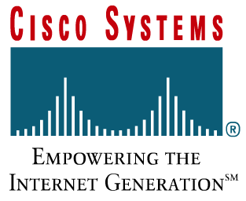
Computer Network & Network Reference Model

Slide 2
Computer Network & Network Reference Model
Overview of Computer Network
OSI Reference Model
TCP/IP Model
Network Topology
Network Devices

Slide 3
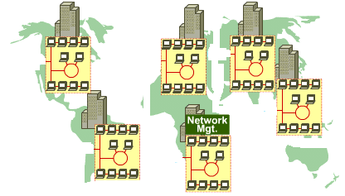
Networks
What is a network ?
A network is an intricately connected system of objects, devices, or people
Companies created networks
As companies expanded, the need for connecting networks at different sites became very important

Slide 4
Data Networks Classifications
LAN( Local Area Networks )
WAN( Wide Area Networks )
Node
Link

Slide 5
LAN/WAN
Local Area Networks (LANs)
Operate locally (cover small areas)
Multi-user access
High speeds expected (up to Gbps/10Gbps)
Error rate is easily controlled
Wide Area Networks (WANs)
Operate over larger areas
Access over serial links, optical links, etc.
Traditionally, have Lower speeds
Error rate can not be easily controlled

Slide 6
Internet
internet:
A network whose nodes are networks
Internet
The largest, open, interconnected computer network in the world.
TCP/IP is the reference model of Internet
Evolved from ARPANET
Internet

Slide 7
Internet with Multi-layer ISP structure
Internet Service Providers (ISP)
User
ISP
ISP₁
Internet
ISP₂

Slide 8
本地 ISP
第三层
本地 ISP
本地 ISP
第二层
第二层 ISP
本地 ISP
第一层
大公司
本地 ISP
大公司
本地 ISP
第一层 ISP
第一层 ISP
第二层 ISP
本地 ISP
本地 ISP
第二层 ISP
NAP
一级 ISP
NAP
一级 ISP
第一层 ISP
第二层 ISP
本地 ISP
本地 ISP
第二层 ISP
第二层 ISP
大公司
本地 ISP
本地 ISP
本地 ISP
本地 ISP
公司
A
B
校园网
校园网
校园网
校园网
主机A → 本地 ISP → 第二层 ISP → NAP → 第一层 ISP → NAP → 第二层 ISP → 本地 ISP → 主机B
Internet with Multi-layer ISP structure

Slide 9




LAN Devices
Multiport repeater, connects PCs; Repeats signals
LAN segmentation; MAC addresses.
Hub
Bridge
Switch
Multiport-bridge; Full bandwidth
Router
Path determination; Packet switching

Slide 10
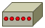
WAN Devices
Path determination; Packet switching
Router
Modem
CSU/DSU
TA/NT1
Analog to Digital;
Remote LAN connections

Slide 11
LAN Services and WAN Services
LAN service: Ethernet, the most popular service
WAN services...
Modem
ISDN
DSL
Frame Relay
ATM
T1/E1
T3
STS-1, STS-3, STS-48 (SONET/SDH)

Slide 12
Data
Data is sent in bits, 1s and 0s.
Data is not the information itself
Data is an encoded form of information which is a series of electrical impulses/optical signals into which information is transmitted for sending

Slide 13
Protocol
It is possible for different types of computer systems to communicate
All devices must speak the same “language” or use the same protocol (use same set of rules).

Slide 14
Data Packets
For transmission, computer data is often broken into small, easily transmitted units
Using the OSI model, these units can be called packets, or frames or segments
Why data packets?
Computers can take turns sending packets
If packet is lost, only small amount of data must be retransmitted.
Data can take different paths.

Slide 15
Source and Destination
Source address specifies the identity of the computer sending the packet.
Destination address specifies the identity of the computer designated to receive the packet.

Slide 16
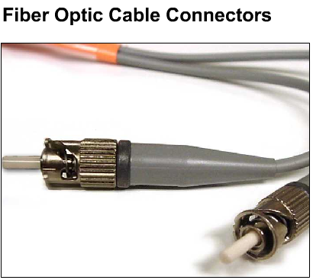
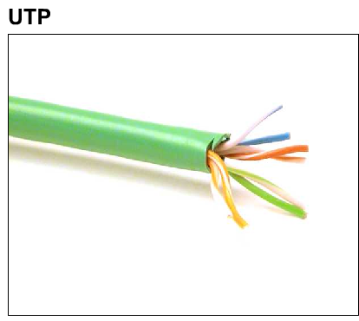
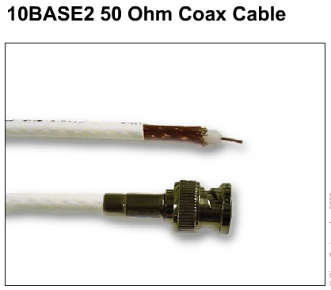
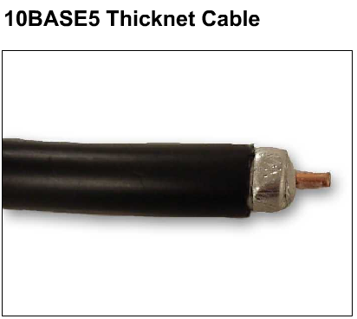
Media Types
AIR
carries light, radio, microwave
Media—material through which data packets travel

Slide 17
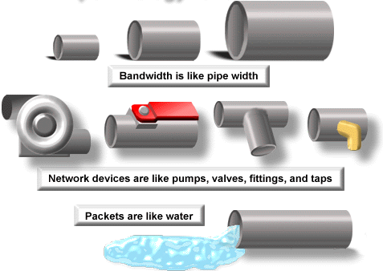
Digital Bandwidth
Bandwidth is the measure of how much information can flow from one place to another in a given amount of time.
Measured in: bits/second (bps)

Slide 18
Throughput
Actual, measured, bandwidth, at a specific time
Throughput ≤ Bandwidth

Slide 19
Computer Network & Network Reference Model
Overview of Computer Network
OSI Reference Model
TCP/IP Model
Network Topology
Network Devices

Slide 20
OSI (Open System Interconnection) Model
Proposed by International Organization for Standardization (ISO)
A network model that help network builders implement networks that could communicate and work together
Describes how information or data moves from one computer through a network to another computer
a layered communication process
Each layer performs a specific task

Slide 21
The OSI Reference Model
Each layer has a unique function.
User interface
Data presentation and encryption
Inter-host connection
End-to-end connections
Addresses and best path
Access to media
Binary transmission
7
6
5
4
3
2
1
Application
Presentation
Session
Transport
Network
Data Link
Physical

Slide 22
Why a Layered Model?
Reduce Complexity
Standardizes interfaces
Facilitates modular engineering
Ensures interoperable technology
Accelerates evolution
Simplifies teaching and learning

Slide 23
The OSI Reference Model
Application
Presentation
Session
The top 3 layers are known as the application layers
because they deal with the user interface, data formatting, and the application access.

Slide 24
The OSI Reference Model
4
3
2
1
Transport
Network
Data Link
Physical
Layers 1-4 are known as the data flow layers
because they control the physical delivery of messages over the network.

Slide 25
Layer 1: The Physical Layer
Keywords: Signal and Media
User interface
Data presentation and encryption
Inter-host connection
End-to-end connections
Addresses and best path
Access to media
Binary transmission
7
6
5
4
3
2
1
Application
Presentation
Session
Transport
Network
Data Link
Physical
Application
Presentation
Session
Transport
Network
Data Link
Physical

Slide 26
Layer 1: The Physical Layer
defines the electrical and functional specifications for the link between end systems (including media)
defines voltage levels, timing of voltage changes, physical data rates, maximum transmission distances, physical connectors, and other, similar attributes

Slide 27
Layer 2: The Data Link Layer
Keywords: frame, media access control
Application
Presentation
Session
Transport
Network
Data Link
Physical
User interface
Data presentation and encryption
Inter-host connection
End-to-end connections
Addresses and best path
Access to media
Binary transmission
7
6
5
4
3
2
1
Application
Presentation
Session
Transport
Network
Data Link
Physical

Slide 28
Layer 2: The Data Link Layer
provides reliable transit of data across a physical link
is concerned with physical (as opposed to logical) addressing, network topology, network access, error notification, ordered delivery of frames, and flow control

Slide 29
Layer 3: The Network Layer
Keywords: Path selection, Routing, Addressing
User interface
Data presentation and encryption
Inter-host connection
End-to-end connections
Addresses and best path
Access to media
Binary transmission
7
6
5
4
3
2
1
Application
Presentation
Session
Transport
Network
Data Link
Physical
Application
Presentation
Session
Transport
Network
Data Link
Physical

Slide 30
Layer 3: The Network Layer
Provide connectivity and path selection between two end systems where routing occurs
These may be located on geographically separated networks

Slide 31
Layer 4: The Transport Layer
Keywords: Reliability, Flow control, Error correction
Application
Presentation
Session
Transport
Network
Data Link
Physical
User interface
Data presentation and encryption
Inter-host connection
End-to-end connections
Addresses and best path
Access to media
Binary transmission
7
6
5
4
3
2
1
Application
Presentation
Session
Transport
Network
Data Link
Physical

Slide 32
Layer 4: The Transport Layer
segments and reassembles data into a data stream
concerned with how reliable transport over an internetwork is accomplished
responsible for reliable network communication between end nodes and provides mechanisms for the establishment, maintenance, and termination of virtual circuits, transport fault detection and recovery, and information flow control

Slide 33
Layer 5: The Session Layer
Keywords: Dialog and Conversations
Application
Presentation
Session
Transport
Network
Data Link
Physical
User interface
Data presentation and encryption
Inter-host connection
End-to-end connections
Addresses and best path
Access to media
Binary transmission
7
6
5
4
3
2
1
Application
Presentation
Session
Transport
Network
Data Link
Physical

Slide 34
Layer 5: The Session Layer
establishes, manages, and terminates sessions between communicating hosts
synchronizes dialog between presentation layer entities and manages their data exchange
offers provisions for efficient data transfer, class of service, and exception reporting of session, presentation, and application layer problems
manages data exchange between presentation layer entities

Slide 35
Layer6: The Presentation Layer
Keywords: Common Format
User interface
Data presentation and encryption
Inter-host connection
End-to-end connections
Addresses and best path
Access to media
Binary transmission
7
6
5
4
3
2
1
Application
Presentation
Session
Transport
Network
Data Link
Physical
Application
Presentation
Session
Transport
Network
Data Link
Physical

Slide 36
Layer6: The Presentation Layer
ensures that information sent by the application layer of one system is readable by the application layer of another system
translates between multiple data representation formats by using a common data representation format
concerned with data structures and negotiation of data transfer syntax
responsible for compression and encryption

Slide 37
Layer 7: The Application Layer
Keyword: Browser
Application
Presentation
Session
Transport
Network
Data Link
Physical
User interface
Data presentation and encryption
Inter-host connection
End-to-end connections
Addresses and best path
Access to media
Binary transmission
7
6
5
4
3
2
1
Application
Presentation
Session
Transport
Network
Data Link
Physical

Slide 38
Layer 7: The Application Layer
closest to the user
provides network services to user applications
does not provide services to any other OSI layer

Slide 39
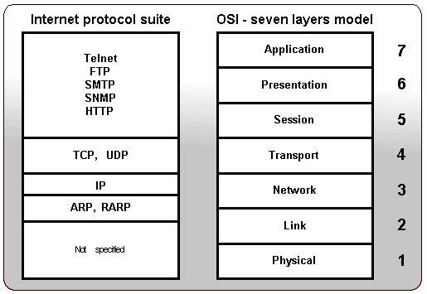
Protocols on ISO layers

Slide 40
Data Encapsulation
计算机 1
计算机 2
AP₁
应 用 程 序 数 据
AP₂
首部
5
H5
数 据 部 分
5
TCP报文段
UDP报文段
4
H4
数 据 部 分
4
IP数据报
IP分组
3
H3
数 据 部 分
3
尾部
帧
2
H₂
数 据 部 分
T₂
2
比特
1
10100110100101 比 特 流 10100110100101
1
物 理 传 输 媒 体

Slide 41
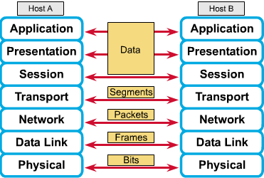
Peer-to-Peer Communications

Slide 42
Computer Network & Network Reference Model
Overview of Computer Network
OSI Reference Model
TCP/IP Model
Network Topology
Network Devices

Slide 43

The TCP/IP Model
The U.S. Department of Defense (DoD) created the TCP/IP reference model
The DoD wants its packets to get through every time, under any conditions, from any one point to any other point.
It brought about the creation of the TCP/IP model
TCP/IP model has since become the standard on which the Internet has grown

Slide 44

The TCP/IP Model
The TCP/IP model has only four layers.
Application
Transport
Internet
Network Access

Slide 45
The TCP/IP Model - Application Layer
Handles high-level protocols, issues of representation, encoding, and session control
TCP/IP combines all application-related issues into one layer, and assures this data is properly packaged for the next layer.

Slide 46
The TCP/IP Model - Transport Layer
Deals with the quality-of-service issues of reliability, flow control, and error correction.
Transmission Control Protocol (TCP)
User Datagram Protocol(UDP)
It package application layer information into units called segments

Slide 47
The TCP/IP Model - Internet Layer
Purpose: Send source packets from any network on the internetwork and have them arrive at the destination independent of the path and networks
Best path determination and packet switching occur at this layer
Internet protocol (IP)

Slide 48
The TCP/IP Model – Network Access Layer
Is also called the host-to-network layer.
It is concerned with all of the issues that an IP packet requires to actually make a physical link, and then to make another physical link.
It includes the LAN and WAN technology details, and all the details in the OSI physical and data link layers.

Slide 49
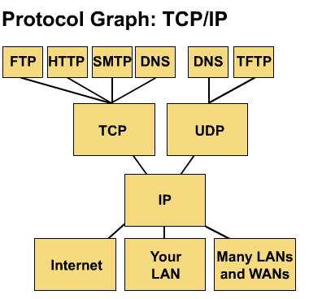
Common TCP/IP Protocols
Application Layer
Transport Layer
Internet Layer
Network Access Layer

Slide 50
Common TCP/IP Protocols
FTP - File Transfer Protocol
HTTP - Hypertext Transfer Protocol
SMTP - Simple Mail Transfer protocol
DNS - Domain Name System
TFTP - Trivial File Transfer Protocol

Slide 51
Similarities of TCP/IP and OSI
Application
Transport
Internet
Network Access
Application
Presentation
Session
Transport
Network
Data Link
Physical
both have layers, networking professionals need to know both
both have application layers, though they include very different services
both have comparable transport and network layers
packet-switched (not circuit-switched) technology is assumed

Slide 52
Differences of TCP/IP and OSI
Application
Transport
Internet
Network Access
Application
Presentation
Session
Transport
Network
Data Link
Physical
TCP/IP appears simpler because it has fewer layers
TCP/IP protocols are the standards around which the Internet developed, so the TCP/IP model gains credibility just because of its protocols.
Typically networks aren't built on the OSI protocol, even though the OSI model is used as a guide.

Slide 53
Computer Network & Network Reference Model
Overview of Computer Network
OSI Reference Model
TCP/IP Model
Network Topology
Network Devices

Slide 54
Topology
Defines the structure of the network
Physical topology: the actual layout of the wire (media)
bus, star, ring, extended star, hierarchical, mesh
Logical topology: defines how the media is accessed by the hosts
token passing

Slide 55
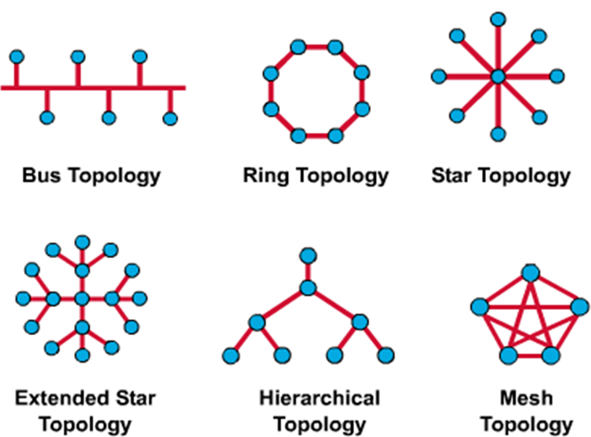
Network Topologies

Slide 56
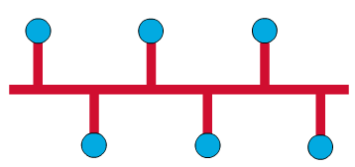
Network Topologies--Bus
Physical Perspective Each host is wired to a common wire.
Advantage: all hosts can communicate directly.
Disadvantage: A break in the cable disconnects hosts from each other.
Logical Perspective
Every networking device to see all signals from all other devices (advantage?)

Slide 57
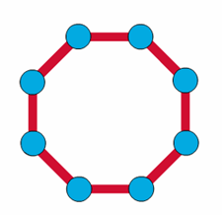
Network Topologies--Ring
Physical Perspective
All devices wired directly to each other in what is called a daisy-chain.
Logical Perspective
In order for information to flow, each station must pass the information to its adjacent station.

Slide 58
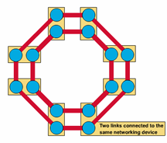
Network Topologies — Dual Ring
Physical Perspective
A dual ring topology is the same as a ring topology, except that there is a second, redundant ring, that connects the same devices.
Advantages: provide reliability and flexibility
Logical Perspective
A dual ring topology acts like two independent rings, of which, only one at a time is used.

Slide 59

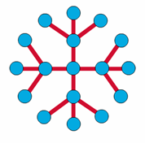
Network Topologies—Star
Physical Perspective A star topology has a central node with all links radiating from it.
Advantage: it allows all other nodes to communicate with each other, conveniently. It also might be desirable for security or restricted access reasons
disadvantage: if the central node fails, the whole network becomes disconnected. Depending on the type of networking device used, collisions can be a problem.
Logical Perspective The flow of all information would go through one device.

Slide 60
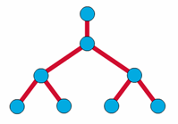
Network Topologies—Tree
The tree topology uses a trunk node from which it branches to other nodes.
binary tree (each node splits into two links)
backbone tree (a backbone trunk has branch nodes with links hanging from it).
Physical Perspective The trunk is a wire that has several layers of branches.
Logical Perspective The flow of information is hierarchical.

Slide 61
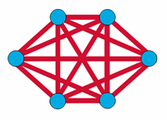
Network Topologies—
Complete (Mesh)
Physical Perspective
has distinct advantages and disadvantages
Advantage: the maximum connectivity and reliability.
Disadvantage: the amount of media for the links, and the amount of connections to the links becomes overwhelming.
Logical Perspective
The behavior of a complete, or mesh topology depends greatly on the devices used.

Slide 62

Network Topologies—Cellular
Physical Perspective
The cellular topology is for wireless technology
Sometimes the receiving nodes move (e.g. cell phone), and sometimes the sending nodes move (e.g. satellite)
Logical Perspective
Nodes communicate with each other directly (though sometimes extremely difficult), or communicate only with their adjacent cells, which is extremely inefficient.

Slide 63
Computer Network & Reference Model
Overview of Computer Network
OSI Reference Model
TCP/IP Model
Network Topology
Network Devices

Slide 64
LAN Devices in a Topology
Hosts—devices connected directly to network segment
printers, computers, servers, FAX, copier
Hosts—not part of any layer, but the functions of the OSI model are performed in software inside host

Slide 65
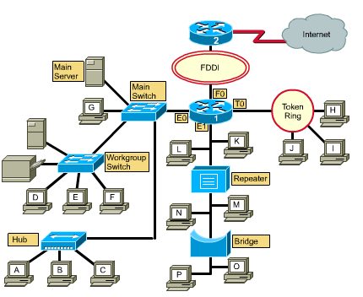
LAN Devices in a Topology

Slide 66
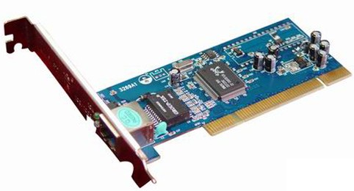
NICs – Layer 2
Carries a unique code called a MAC address
Is used to control data communication for the host on the network
Translates parallel signal produced by computer into serial format to send over the network
Transceiver used to convert signals as well as send and receive bits
IP 地址
硬件地址
计算机
CPU 和
存储器
适配器
（网卡）
至局域网
串行通信
并行
通信
生成发送的数据
处理收到的数据
把帧发送到局域网
从局域网接收帧
Provides the host’s access to the medium

Slide 67
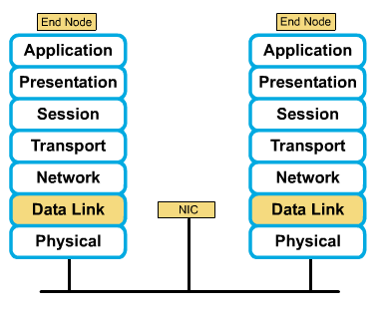
NICs – Layer 2

Slide 68
Media – Layer 1
Carries a flow of information in bits
The means by which signals travel from one networked device to another

Slide 69
Repeaters – Layer 1
used to extend the length of the network
clean, amplify, and resend signals that are weakened by long cable
regenerate (amplify) and retime network signals at the bit level to allow them to travel a longer distance on the media
perform no filtering

Slide 70
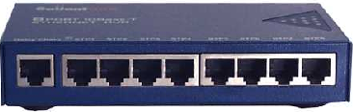
Hubs – Layer 1
used to regenerate and retime network signals
propagate signals
cannot filter traffic
cannot determine the best path
used as network concentration points
sometimes called multiport repeaters

Slide 71
Repeaters/Hubs - Differences
Repeater typically has only two ports and a hub generally has from four to twenty or more ports.
Repeater receives on one port and repeats on the other, while hubs receive on one port and transmit on all other ports.
Hubs most commonly found in Ethernet 10Base T or 100Base T networks.

Slide 72
Hub

Slide 73
Bridges – Layer 2
purpose is to filter traffic on a LAN—to keep traffic local—yet allow connectivity to other segments of the LAN for traffic that is directed there
keep track of MAC addresses that are on each side of the bridge and make decisions based on this MAC address list
more intelligent than hubs
collect and pass packets between segments
create collision domains
maintain address tables

Slide 74
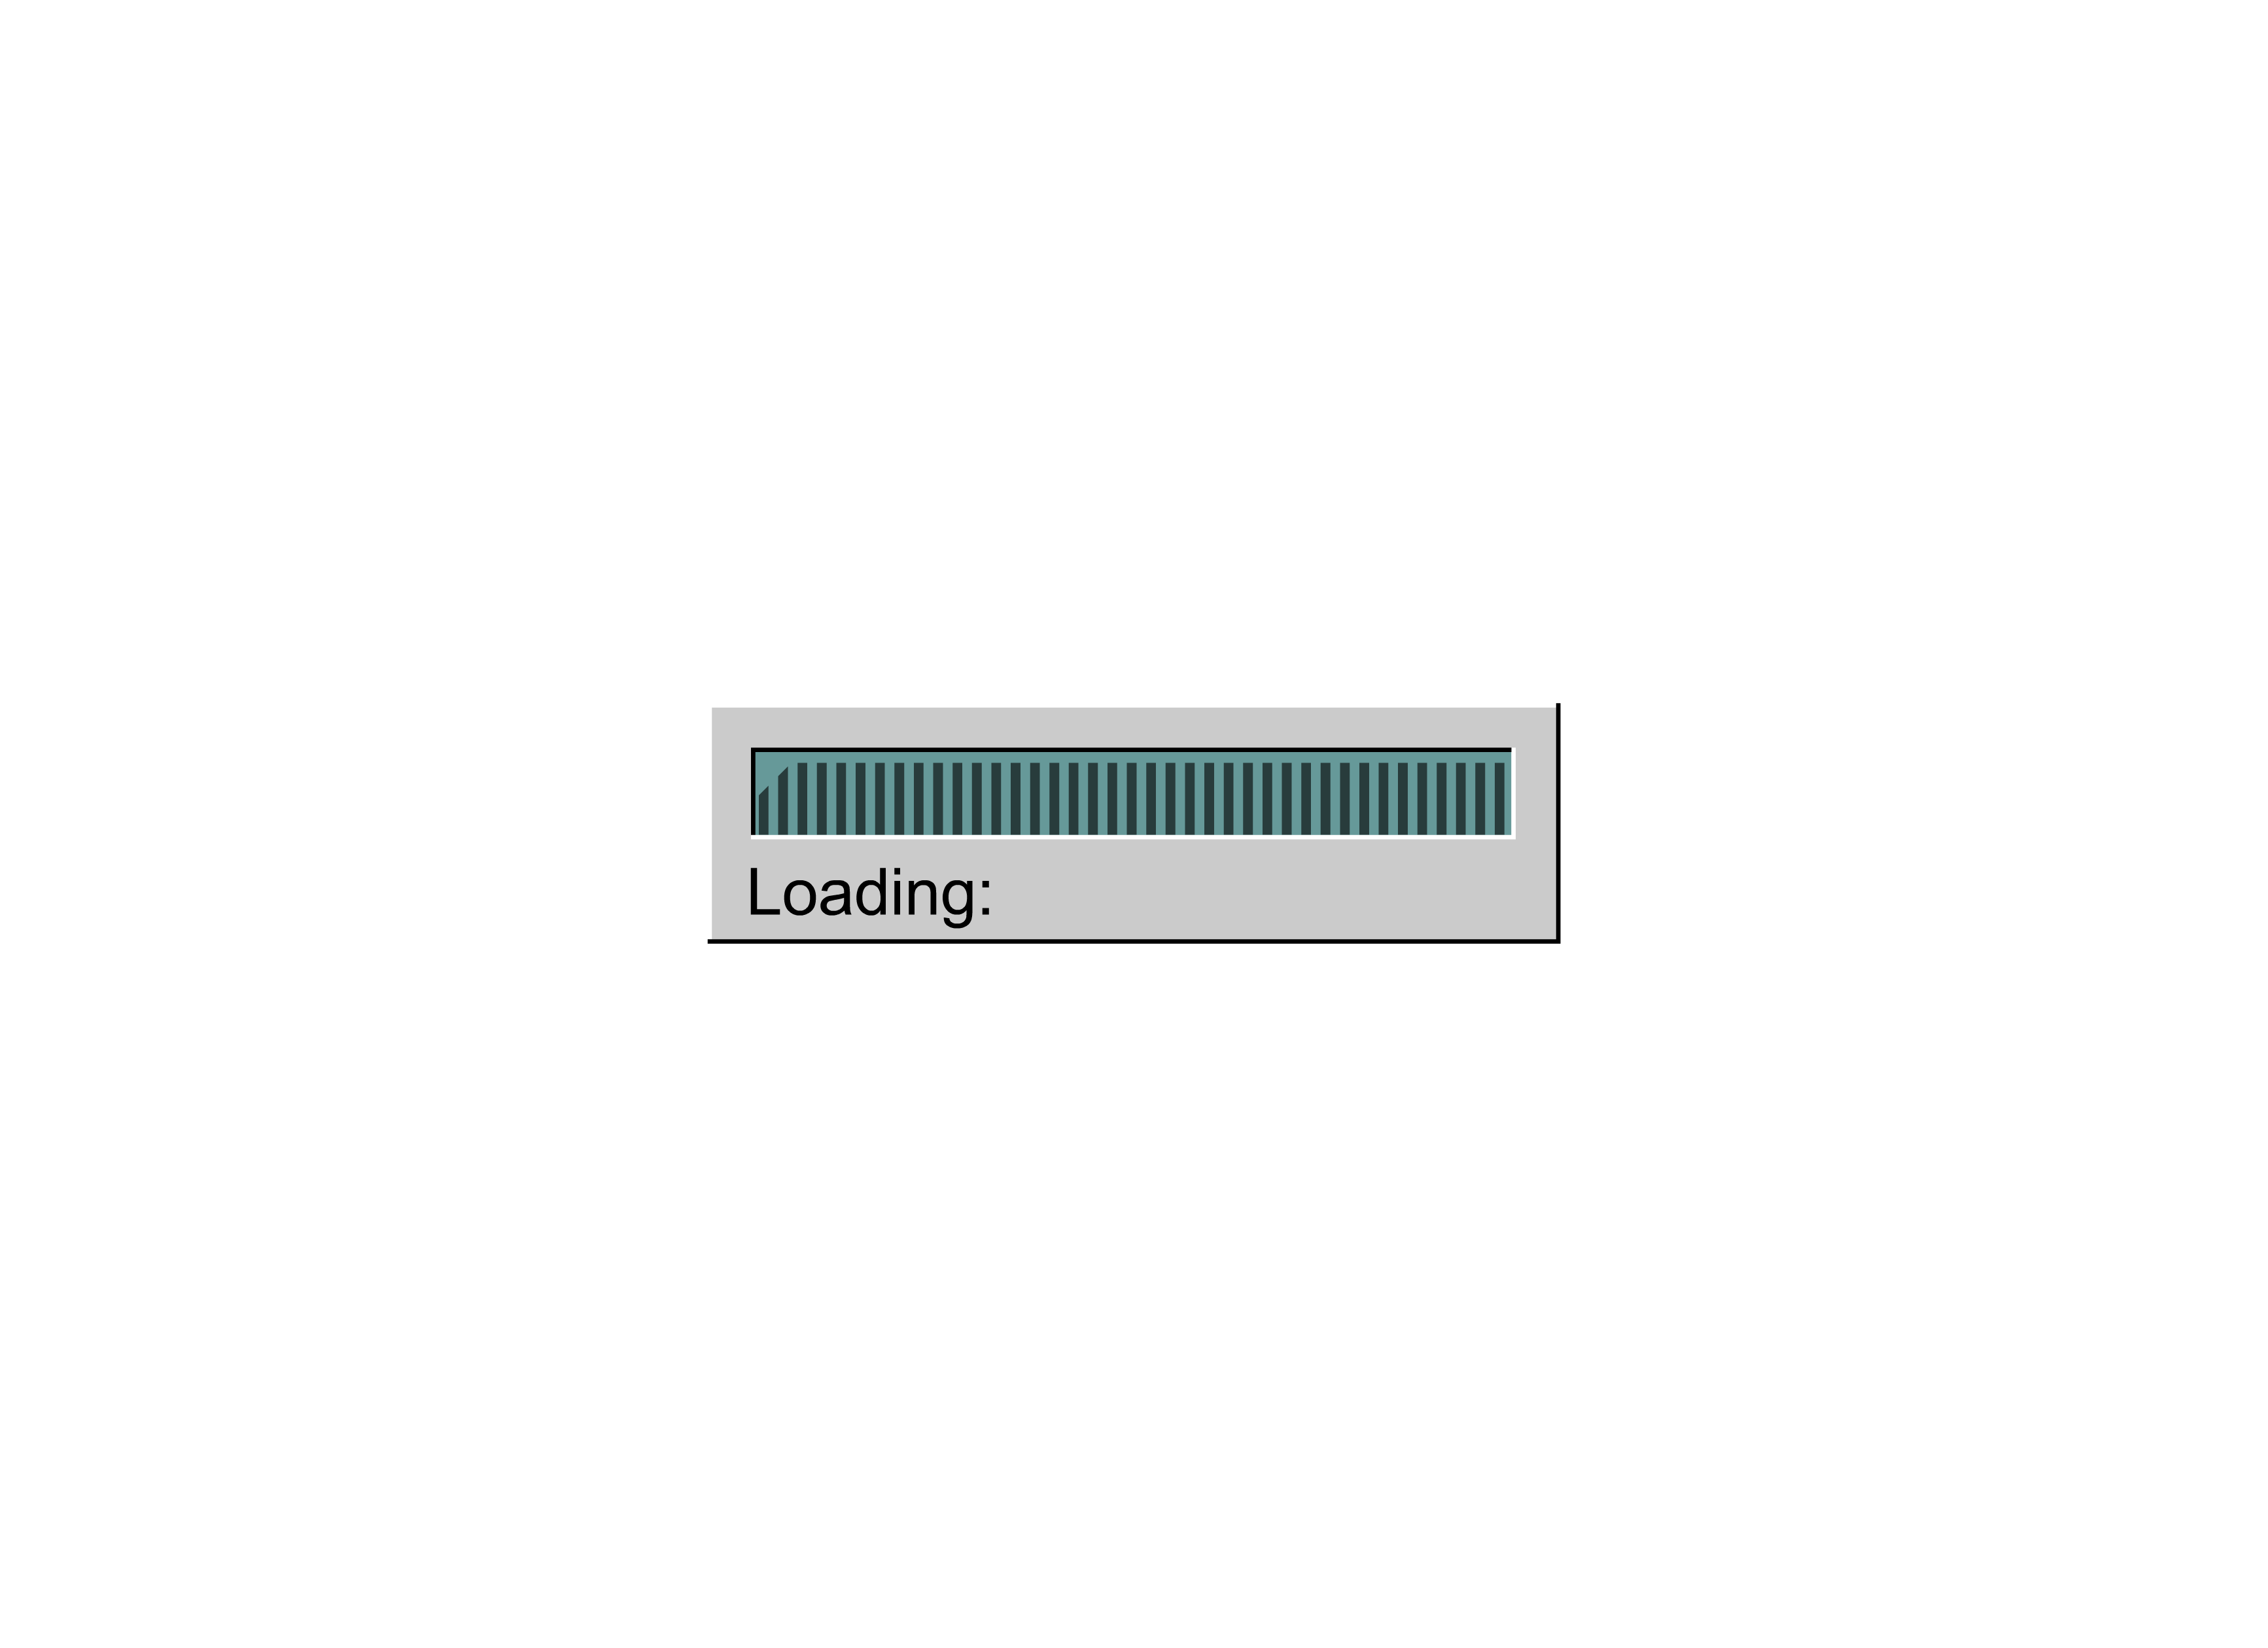

Slide 75
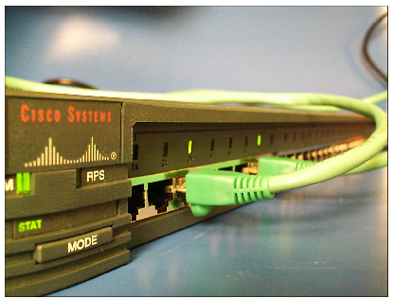
Switches – Layer 2
used to concentrate connectivity
combine the connectivity of a hub with the traffic regulation of a bridge
switch frames from incoming ports to outgoing ports providing each port with full bandwidth
provide separate data paths

Slide 76
Routers – Layer 3
important traffic-regulating device in large networks
Make decisions based on network addresses
examine packets (Layer 3 data), choose the best path for them, and then switch them out the proper outgoing port
two primary purposes: path selection and switching of packets to best route

Slide 77
Clouds – Layers 1-7
all the devices that connect your computer to some very distant com-puter, perhaps on another continent
contain NICs, switches, bridges, routers, gateways, and other net-working devices

Slide 78
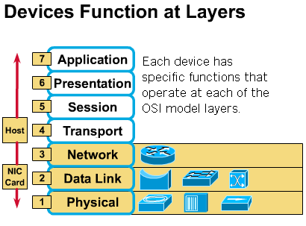
Evolution of Networking Devices and the OSI Layers

Slide 79
Evolution of Networking Devices and the OSI Layers
hosts and servers operate at Layers 1 – 7; they perform the encapsulation process
transceivers, repeaters, and hubs are all considered active Layer 1 devices because they act only on bits and require energy
patch cables, patch panels, and other interconnection components are considered passive Layer 1 components because they simply provide some sort of conducting path

Slide 80
Evolution of Networking Devices and the OSI Layers
NICs are Layer 2 devices because they are the location of the MAC address; but because they often handle signaling and encoding, they are also Layer 1 devices.
Bridges and switches are Layer 2 devices because they use Layer 2 information to make decisions about whether to forward packets.
Routers are Layer 3 devices because they use Layer 3 addresses to choose best paths and to switch packets to proper route.

Slide 81
Packet Flow Through Clouds
NICs
Switches
Bridges
Routers
Gateways (protocol transformation)
PCs (all devices that operate at all levels of the OSI model)

Slide 82


谢 谢！

